Slide 1

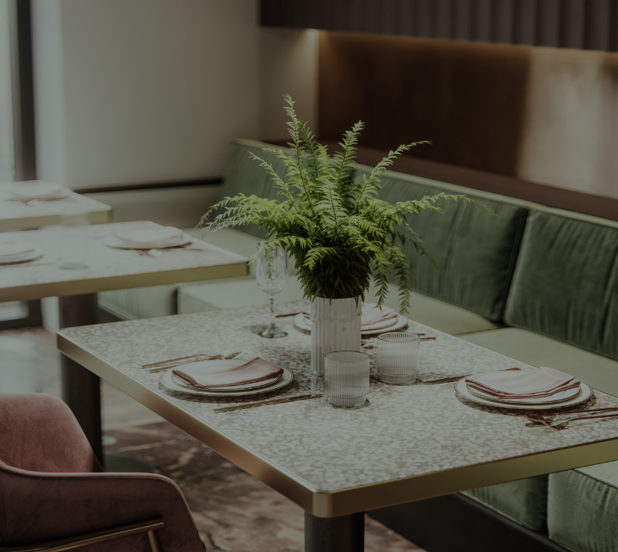
Database MANAGEMENT PROJECT
YUNUS EMRE KARADAĞ
BAHAR YETİŞ
İSA YILDIRIM
ASEL MOLDOMAMBETOVA

Slide 2
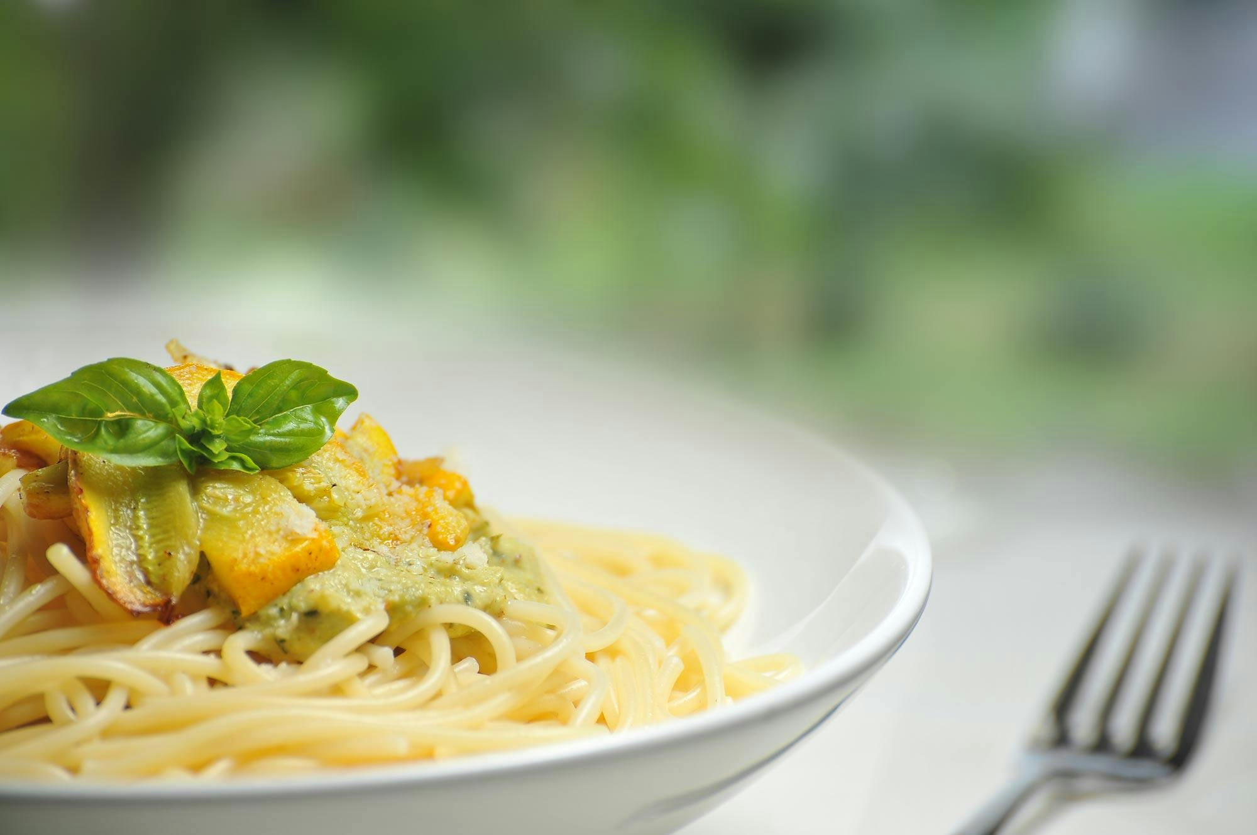
PURPOSE AND SCOPE
The aim of this project is to create a database for the Online Reservation and Order Management System. This will ensure the satisfaction of both the users and the restaurant owners and employees.
The system will provide a web and mobile-based platform for a growing restaurant chain. Customers will be able to make table reservations, place orders, and leave feedback. Waiters will manage customer interactions, while the kitchen staff will receive order details. Managers will oversee system configurations, user accounts, and perrformance metrics.

Slide 3
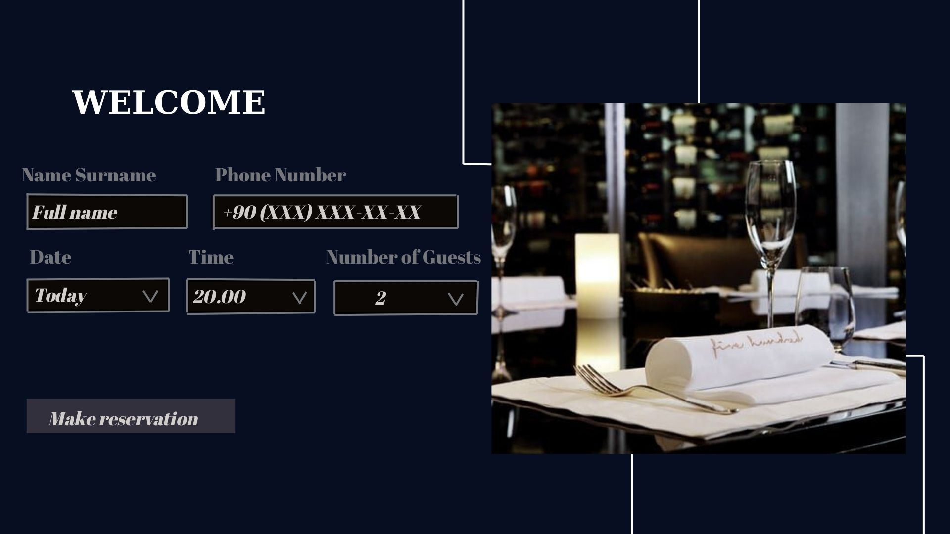
CASE(SCENERİO)
The owners of a restaurant specializing in meat and seafood, faced with an increasing number of customers and the restaurant evolving into a chain, are in search of a solution that will both enhance the customer experience and reduce the workload of their staff. In this context, they decide to develop a mobile/web application as part of the restaurant's digital transformation process. Through this system, customers will be able to log into the application, fill in their personal information, view available tables, and make reservations for their preferred seating. They will also be able to browse the menu via the application, place their orders directly, and track the status of their orders in real time. Payment can be made either through the system or via cash/card, depending on the customer's preference. Additionally, customers will be able to request a waiter through the application and leave feedback about their experience. This feedback will be visible to and analyzed by the managers. The system will also provide various conveniences for the staff. The kitchen team will be able to view customer orders along with allergen information, while waiters will be able to track the tables assigned to them and the related orders through the system, as well as update the status of those tables. Managers will be able to add and update menu items and categories, manage table arrangements, review reservation statistics, and oversee employee accounts.

Slide 4

USER ROLES AND PERMISSIONS
CUSTOMERS
WAITSTAFF
Creating, canceling, updating reservations and viewing table; placing orders, making payments, tracking orders, and leaving feedback
Viewing tables assigned to customers, viewing orders and payments, update new status of the table.
KITCHEN TEAM
manager
Viewing customer preferences/allergies and order notes. ​
Managing users, system settings, tables, and menus; analyzing feedback and performance, and managing orders and payments, update new status of the table.

Slide 5

DEFINITION OF POSTGRESQL
Why is PostgreSQL suitable for a restaurant website?
A restaurant website may include features like:
Food menu
Table reservations
Online food ordering
User registration and login
Review and rating system
PostgreSQL is a powerful, open-source, object-relational database management system. It is used to store, manage and process data. PostgreSQL is especially popular in complex web applications due to its reliability, security and extensibility.

Slide 6
PostgreSQL handles all of these effectively because of:
✅ Reliability — data protection, backups, and high fault tolerance
✅ Complex queries — efficient handling of related data (e.g. orders, customers, reservations)
✅ Security — supports roles, permissions, and encryption
✅ Scalability — suitable for both small cafés and large restaurant chains
✅ Geodata support — useful for showing the restaurant location on a map
How does it work on the website?
A customer visits the website and sees the menu — data is loaded from the menu_items table.
They place an order — a new record is created in orders and order items
They register or log in — their information is saved in the customer table.
They book a table — booking details are saved in reservations.
The manager can add or edit dishes through the admin panel.

Slide 7

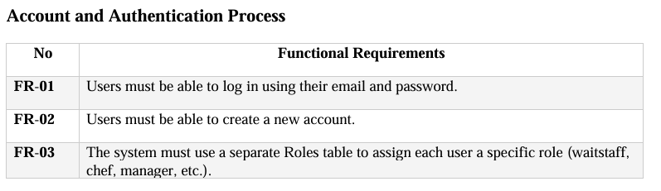
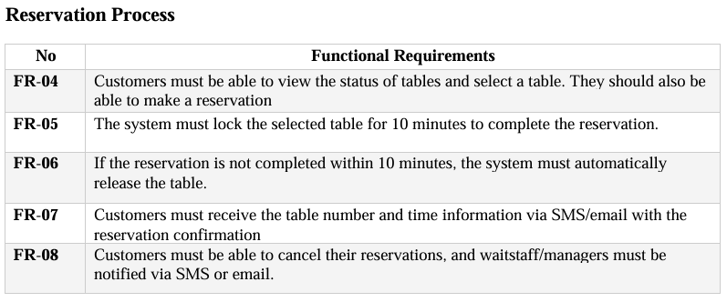
Functıonal requırements

Slide 8
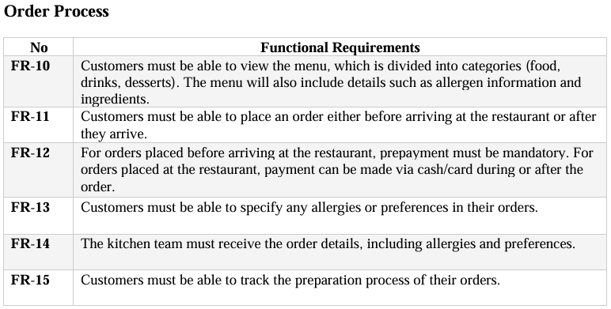
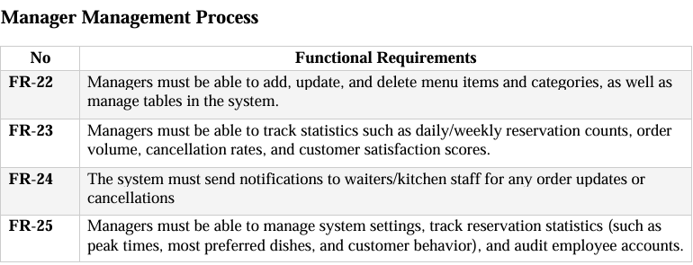
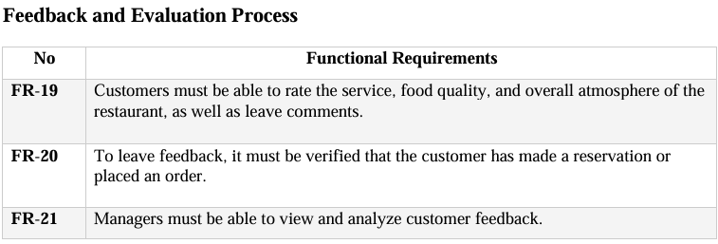
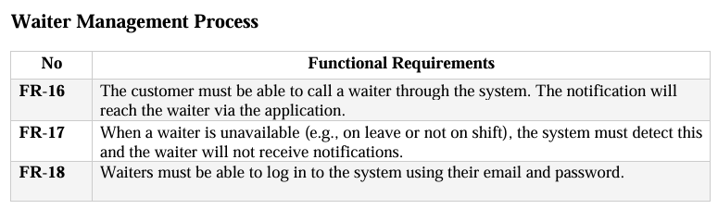

Slide 9
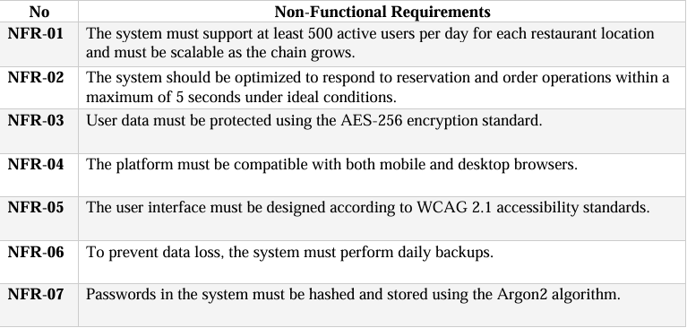
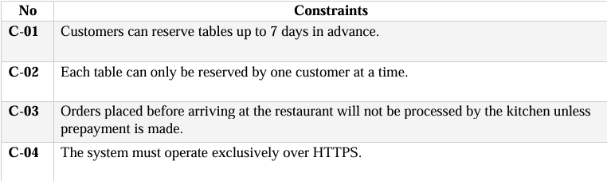
NON-FUNCTIONAL REQUIREMENTS AND CONSTRAINTS

Slide 10
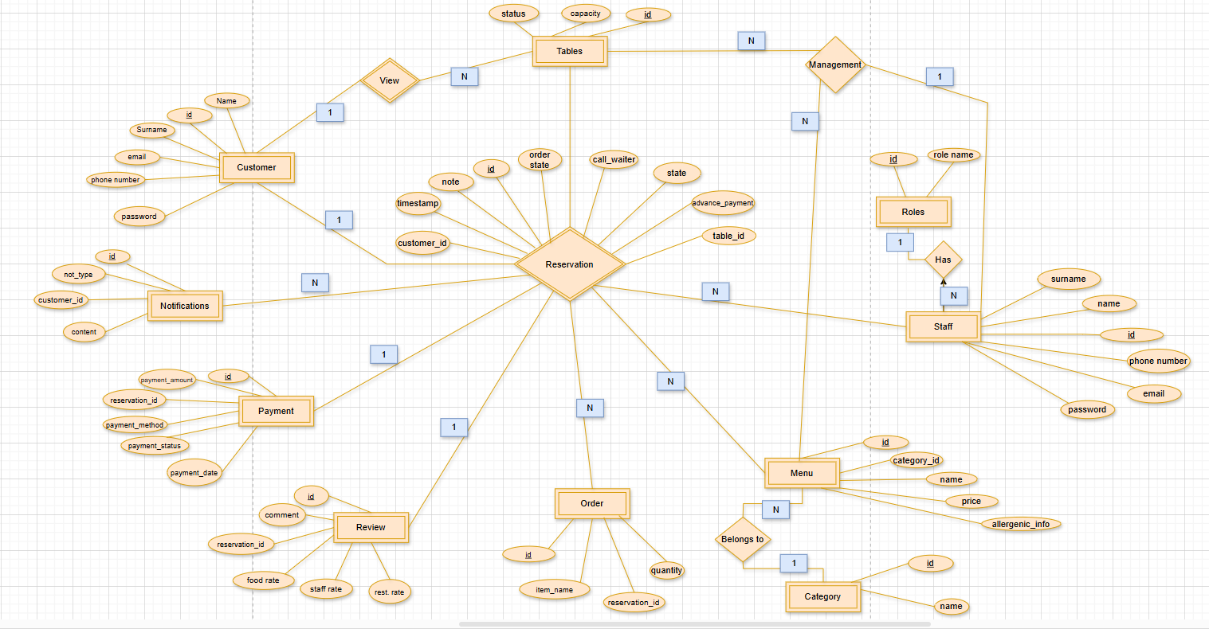
ER DIAGRAM

Slide 11
































TABLES
TABLES

Slide 12
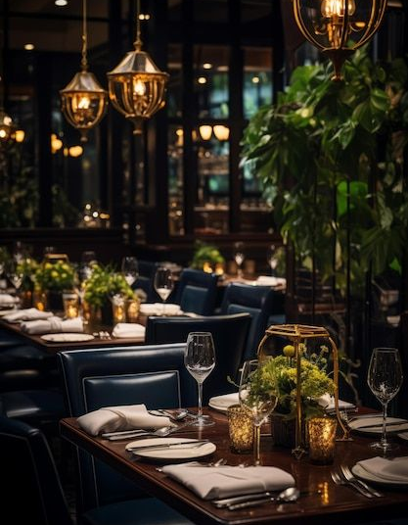
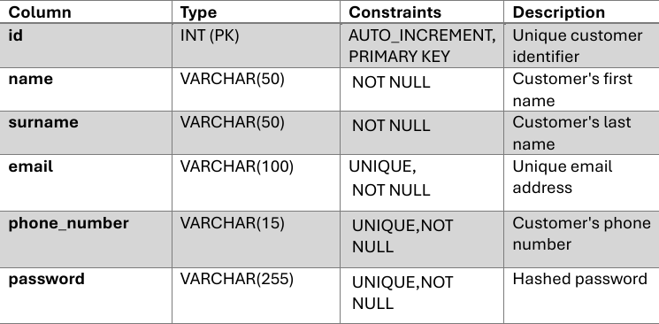
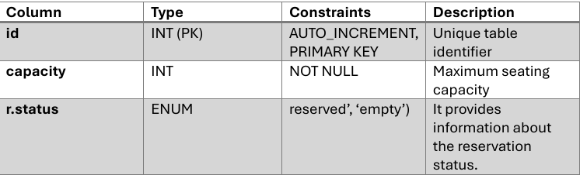
CUSTOMER TABLE
TABLES TABLE

Slide 13

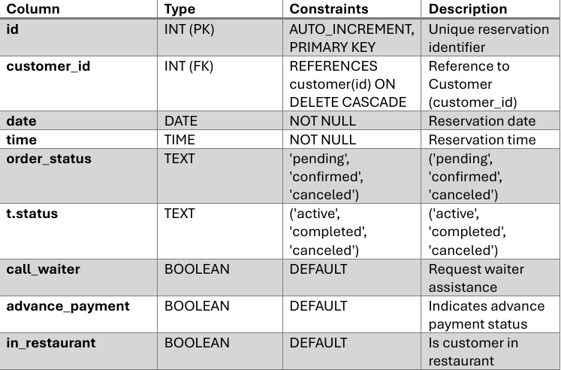
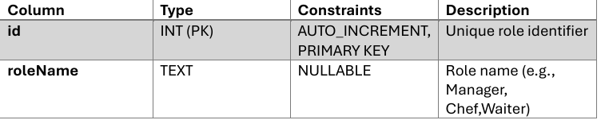
RESERVATION TABLES
ROLES TABLE

Slide 14
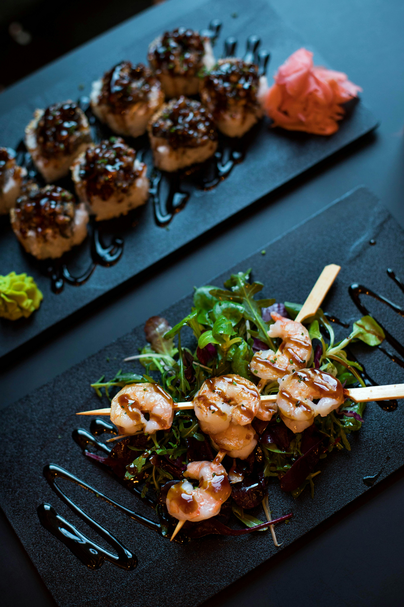
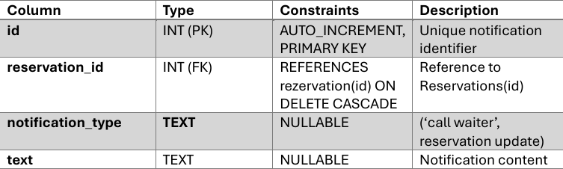
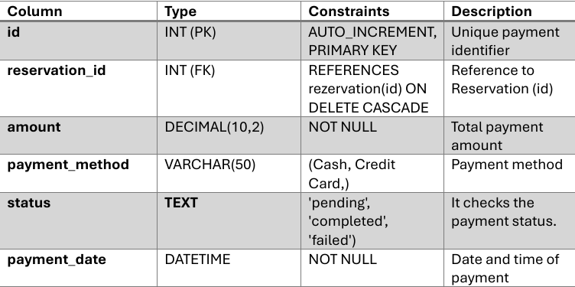
NOTIFICATIONS TABLE
PAYMENT TABLE

Slide 15
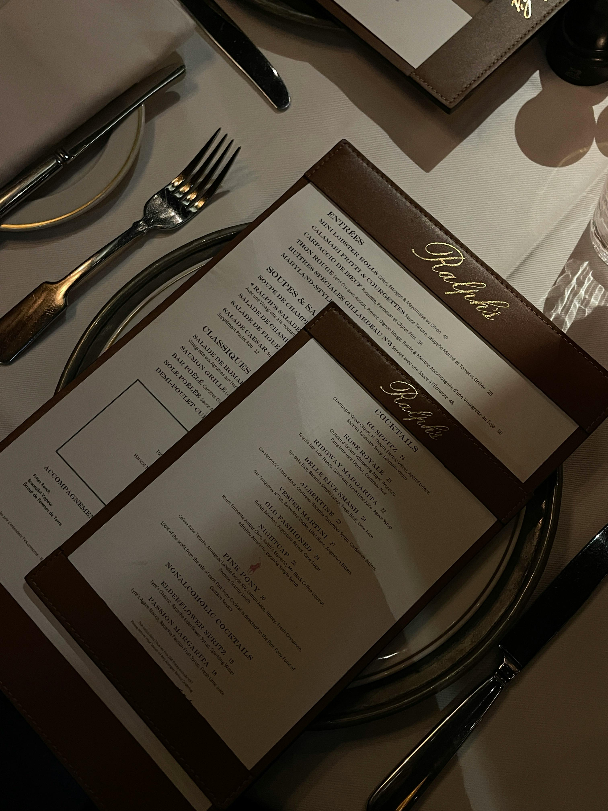
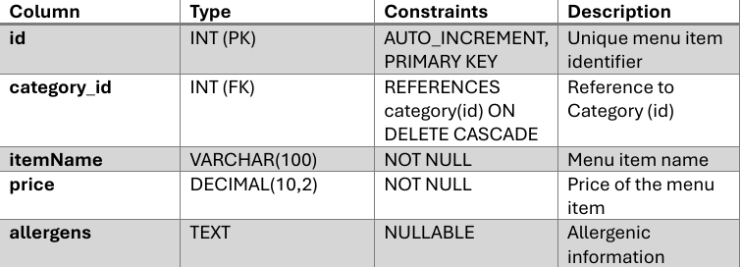
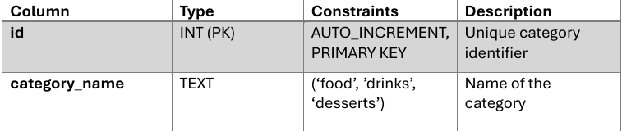
MENU TABLES
CATEGORY TABLE

Slide 16

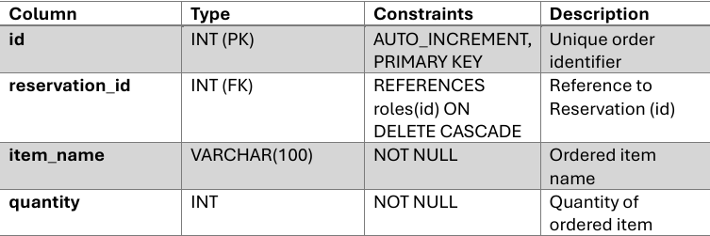
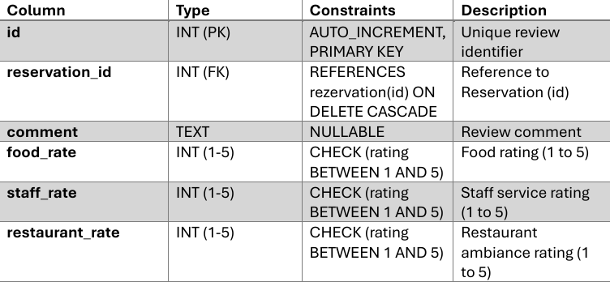
ORDER TABLE
REVİEW TABLE

Slide 17
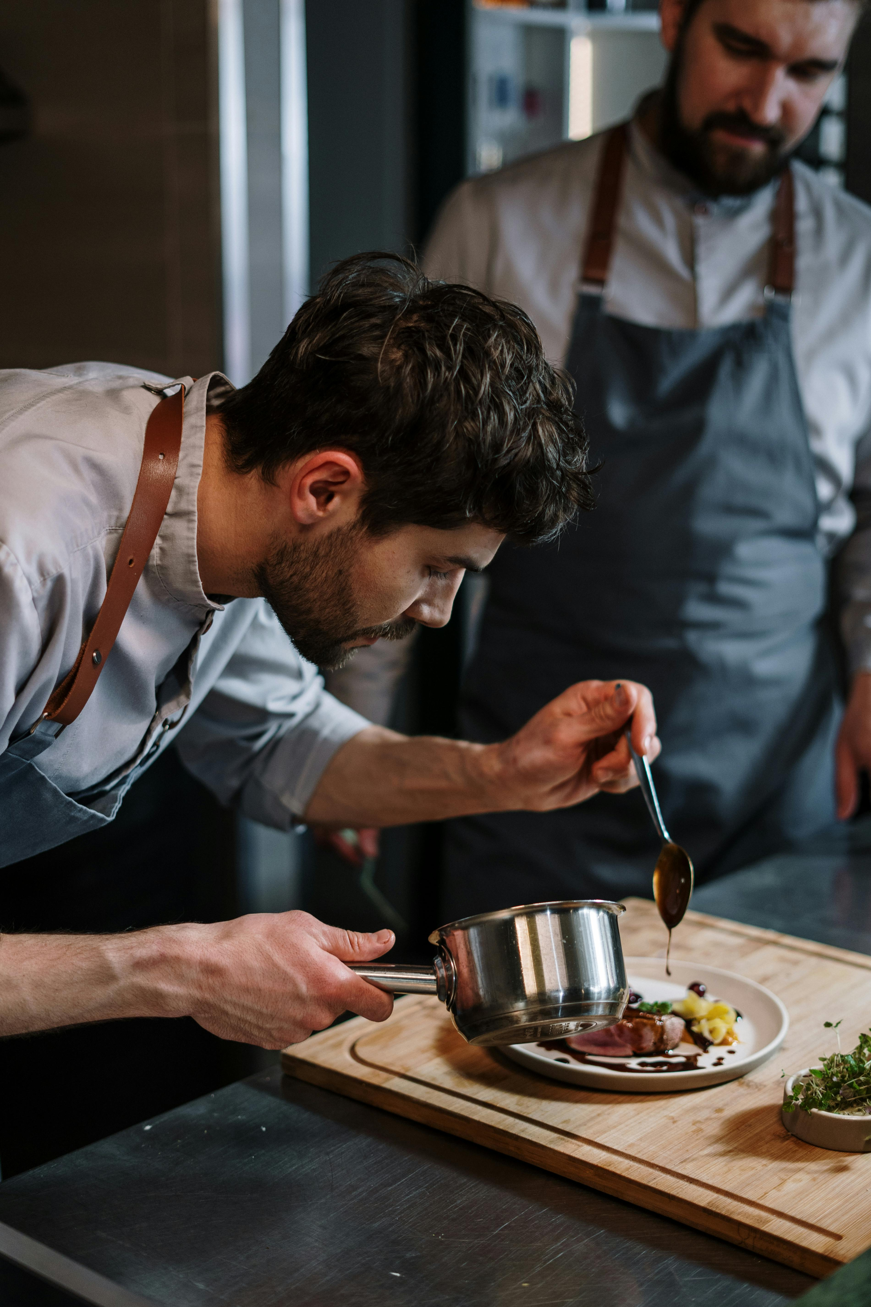
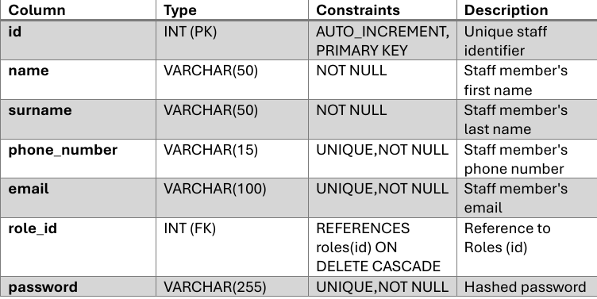
STAFF TABLES

Slide 18
QUERIES
Customers
Managers
Waiters
Kitchen Team
View empty tables
View reservations and customer details
View reservations and customer details
View the order details
View the menu with categories and allergens
View staff roles and details
View all notifications about the reservations
Top dishes ordered by customers
View ratings about restaurant
View the order details and rates.
View all notifications about the reservations
Calculating revenue from customers and payment details

Slide 19
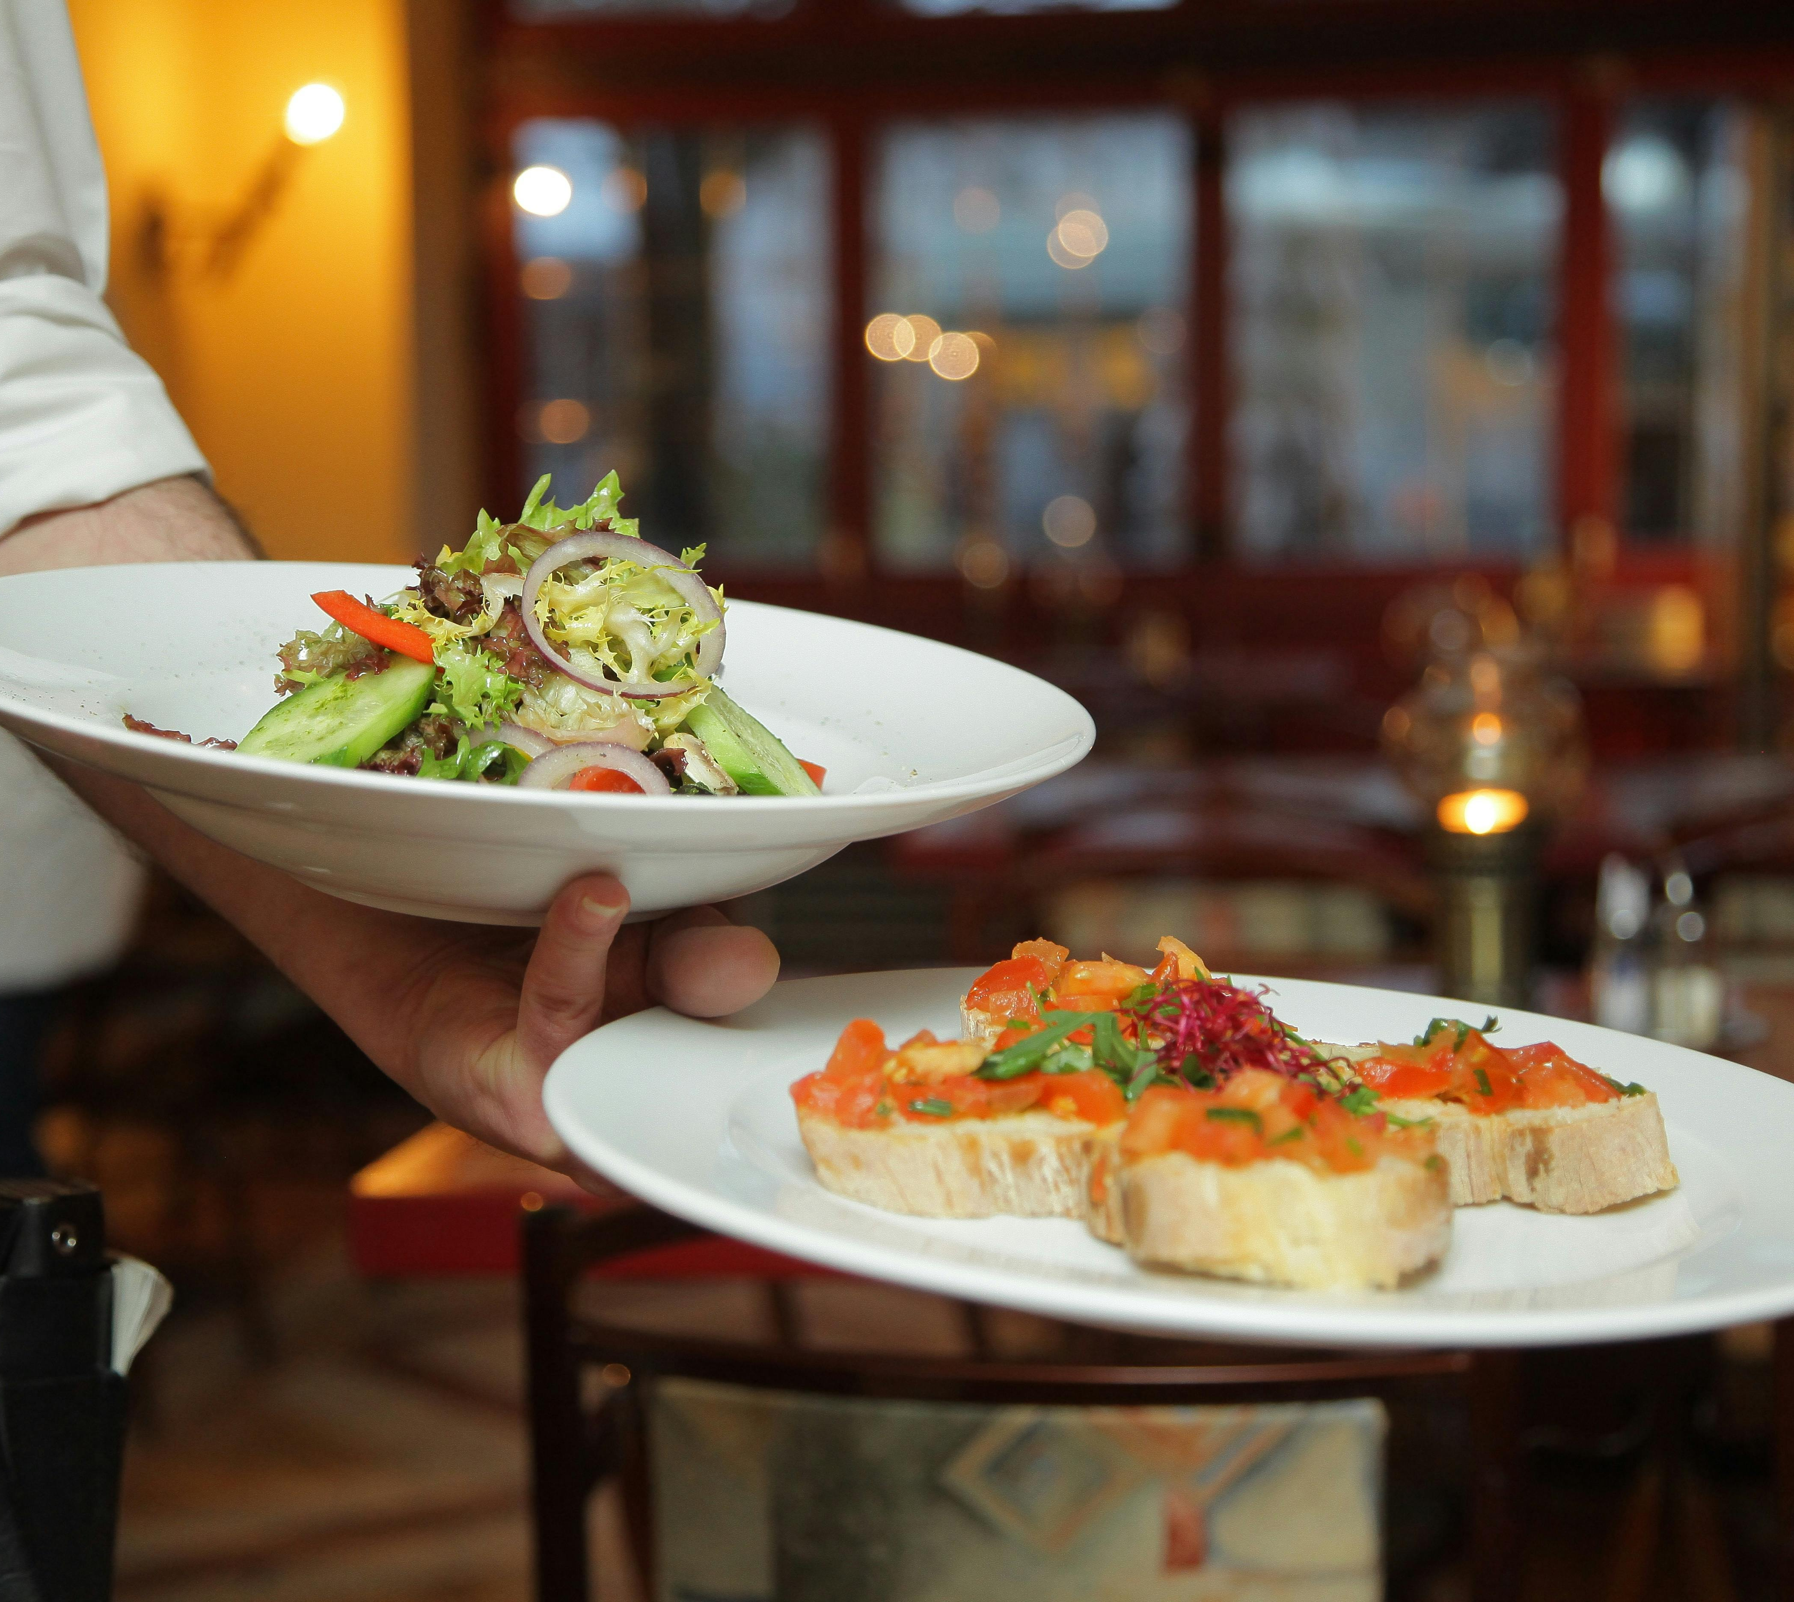
Thank You

